Slide 1
Degradation Aware Power-Split for Series-Parallel Hybrid Electric Vehicle
Satish Vedula

Slide 2
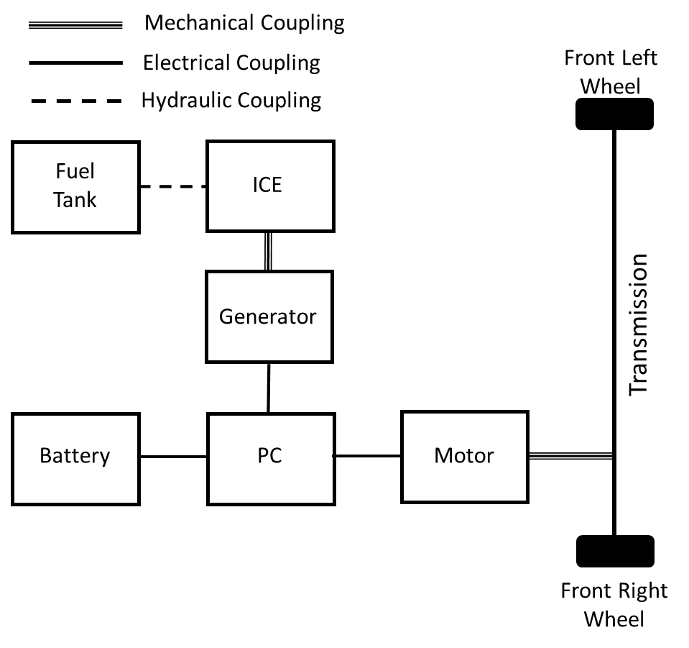
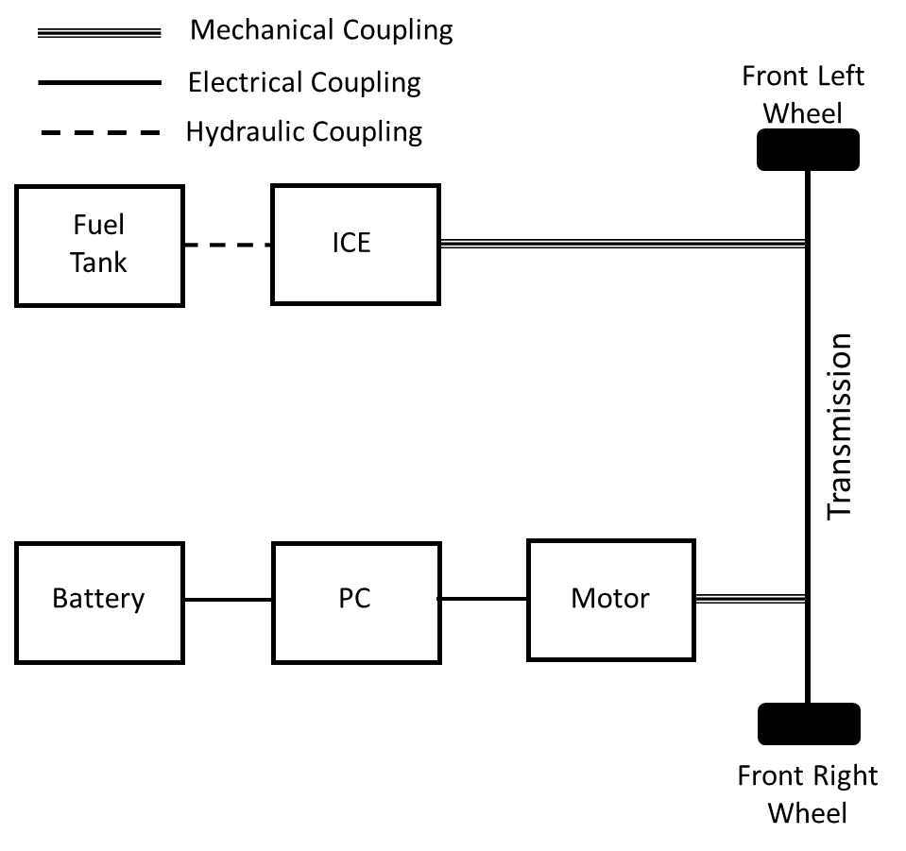
Hybrid Electric Vehicle (HEVs)
Types of HEV
Series HEV
Parallel HEV
Series-Parallel HEV
Schematic of Series HEV
Schematic of Parallel HEV

Slide 3
Series-Parallel HEV Drive-train (SPHEV)
Schematic of Series-Parallel HEV
Types of SPHEV
ICE heavy SPHEV
Electric motor heavy SPHEV
Main Modes of Operation
Acceleration
Deceleration
Normal Driving
Regenerative braking
Battery charging while driving
Battery charging while standstill
Components to be designed
Electric machine (Generator or Motor)
Battery
Engine
Driveline Dynamics
Mechanical Coupling
Electrical Coupling
Front Left Wheel
Hydraulic Coupling
Fuel
Tank
ICE
Transmission
Generator
Driveline
Battery
PC
Motor
Front Right Wheel

Slide 4
Power-Flow in HEV
Power flow during start-up ( )
The main advantage of series-parallel HEV is that they use only battery power for starting.
Power flow during acceleration
Path indicated by ( )
Both ICE and Battery supply power.
During normal driving only ICE active.
Braking path ( )
Charging while driving ( )
Mechanical Coupling
Electrical Coupling
Front Left Wheel
Hydraulic Coupling
Fuel
Tank
ICE
Transmission
Generator
Battery
PC
Motor

Slide 5
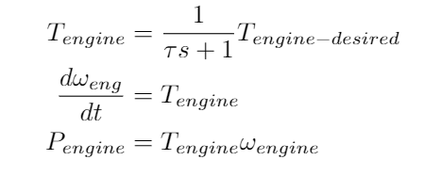
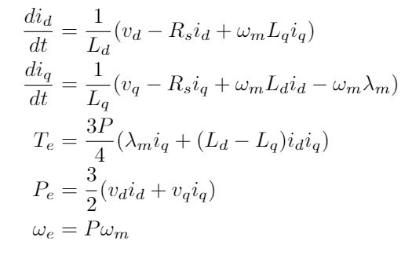

Component Modelling
Engine
Modelled as a first order filter with a time constant.
Electric Machine
3-Phase AC Permanent Magnet Synchronous machine.
States
Direct and Quadrature axis currents.
Inputs
Direct and Quadrature axis voltages.
Battery Model
Current reference first order filter model.
NiMH or Li+ based on vehicle price.
Driveline Dynamics
Dynamic equation in terms of wheel angular velocity.

Slide 6
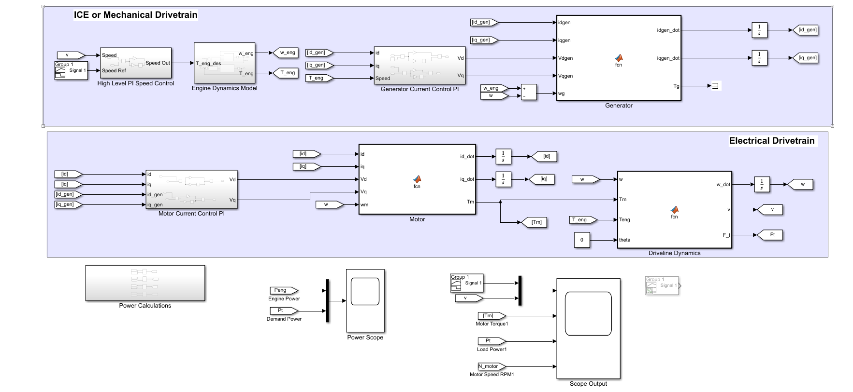
Current Status

Slide 7
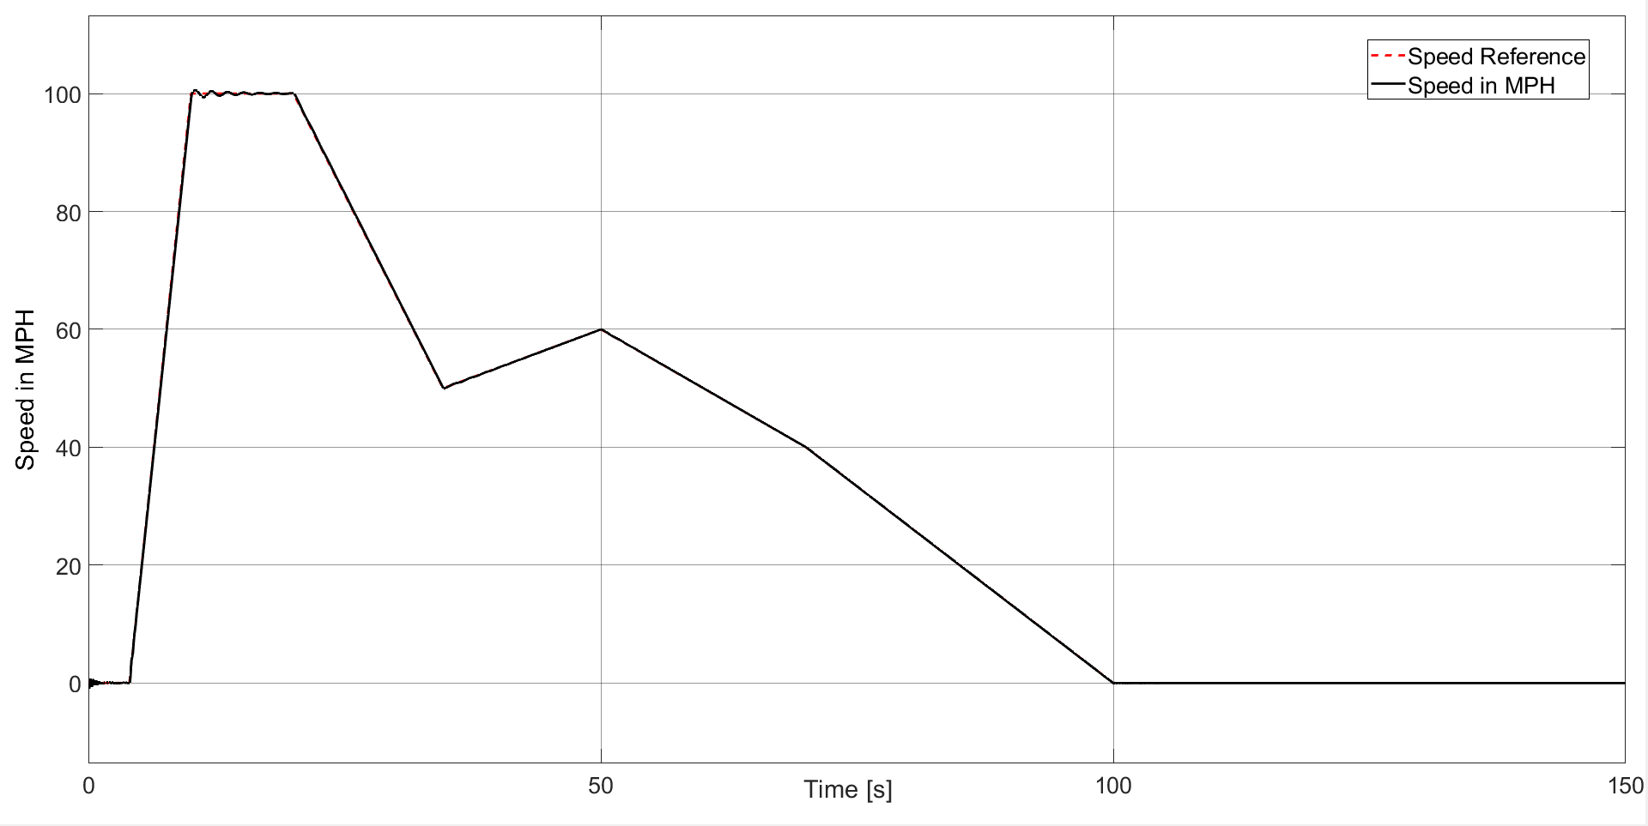
Simulation Result

Slide 8
Up Next
Integrate Battery model into the model.
First, design simple power allocator to validate the model.
Design and Implement ADMM model for HEV model considering the degradation of the battery.

